Slide 1

Government Polytechnic Nagpur
Information Technology
“Elevating Syscalls to privileged Actions to Prevent Unauthorized Software Attacks”
Parth P. Thakre
IT 5th Semester
Presenter
Atharva P. Bhajan
IT 5th Semester
Co-Presenter
Under Guidance of:
Dr. A. R. Mahajan
HOD, Information Technology
Prof. L. L. Bhadekar
Lecturer, Information Technology
1

Slide 2



From 2020 to 2022, there was a 105% increase in ransomware attacks globally.
In 2021 alone, ransomware attacks increased by 151%, with over 68% of companies globally reporting an attack.
The average ransom payment in 2022 was around $812,360.
Rising CyberAttacks
Downtime costs are another significant factor, with companies losing an average of 16 days post-ransomware incident.
Global ransomware damage was expected to reach $20 billion in 2021, up from $11.5 billion in 2019, with projections estimating $265 billion by 2031.
2
2

Slide 3

System call
A system call is a mechanism that allows programs to request services or resources from the operating system's kernel.
System calls provide an interface between user-level applications and the low-level kernel operations
System Call Vulnerabilities
Weak security Policy Enforcement
Kernel
Access Exposure
Privilege Escalation Risks
Unauthorized Resource Access
3

Slide 4








Proposed Solutions till now
pTrace
SElinux
Seccomp
Nexpoline
2000
2005
2023
1980
Performance Overhead
Single Process Control
Security Risks
Complexity
Complex Configuration
Hard to Debug
Overly Restrictive:
Limited Functionality
Difficult Policy Creation
No Adaptation to New Threats
No Process Behavior Analysis
Lack of Behavioral Analysis
Static Policy Management
Cryptographic Weaknesses
Scalability Issues
4

Slide 5



NexPro
NexPro introduces a fine-grained, policy-driven approach that enforces strict control over syscalls based on behavioral learning, process lineage, and cryptographic verification.
NexPro transforms system calls into privileges, ensuring only authorized entities can make them.
NexPro overcomes the limitations by Nexpoline.
5

Slide 6

Superior Flexibility: NexPro’s architecture is more adaptable than traditional syscall interception methods, making it suitable for dynamic workloads and modern security demands.
Efficient Performance: NexPro optimizes syscall validation with minimal overhead, maintaining system efficiency while providing robust security.
Features
Enhanced Security: NexPro leverages techniques like MPK and SUD to offer granular control over system calls, ensuring higher protection against unauthorized access.
Advanced Anomaly Detection: It integrates behavioral learning and real-time anomaly detection to adapt to evolving threats.
6

Slide 7


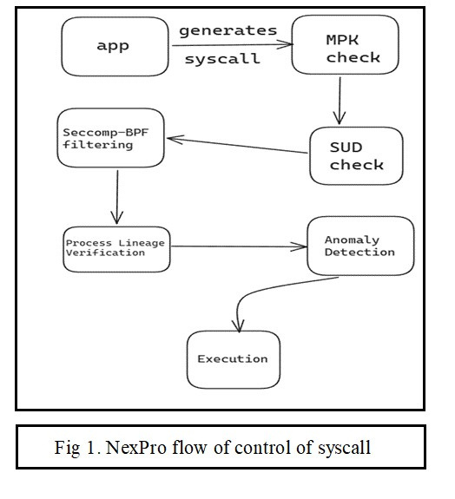
Work
Flow
Application Generates a Syscall
1
2
Memory Protection Keys (MPK) Check
3
Syscall User Dispatch (SUD) Check
Seccomp-BPF Filtering (Optional)
4
Behavioral Learning and Fine-Grained Policies (Future Enhancements)
6
Process Lineage Verification
5
Syscall Execution & Response
7
7

Slide 8
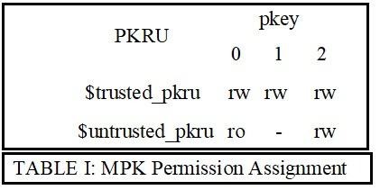
Memory Protection Keys (MPK)
MPK is a hardware-based mechanism introduced by Intel that allows processes to assign protection keys to memory pages. It enables the isolation of memory sections and prevents unauthorized access based on privileges.
Key Features:
16 unique protection keys per thread.
Quick context switching without requiring TLB flushes.
Enhanced isolation for sensitive memory regions during syscall interception.
8

Slide 9
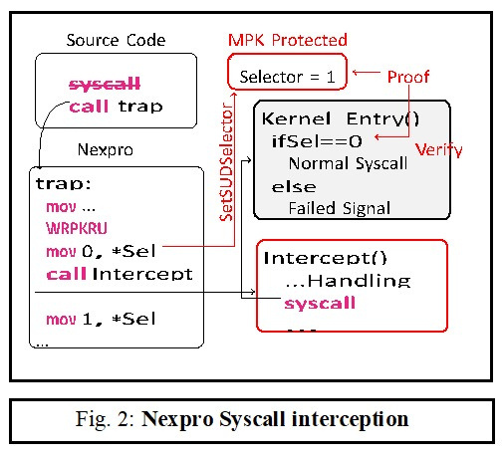
Supervisor Mode Access Prevention (SUD)
SUD is a security feature that blocks user-mode access to certain memory areas when the CPU is operating in kernel mode, preventing malicious access.
.
Key Features:
Prevents kernel memory from being accessed during system call execution.
Automatically blocks unauthorized or unintended data leaks during syscall transitions.
SUD ensures system call security by enforcing strict separation between user and kernel space, preventing privilege escalation attacks
9

Slide 10
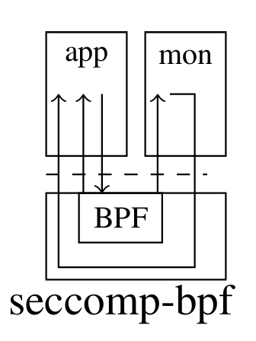
Seccomp (Secure Computing Mode)
Seccomp is a Linux kernel feature that allows developers to restrict the set of system calls that an application can execute. It enhances security by limiting exposure to potential vulnerabilities in the kernel.
User Space
Key Features:
Allows filtering and blocking of specific system calls.
Works through a simple BPF (Berkeley Packet Filter) mechanism to define policies.
Seccomp’s fine-grained syscall filtering strengthens NexPro’s capability to enforce dynamic policies for high-security applications.
Minimal performance impact, enabling efficient syscall management.
Kernel Space
10

Slide 11
Syscall Logs
Comprehensive Syscall Auditing: NexPro logs every system call, capturing key details like process ID,
syscall arguments, and decision outcomes, ensuring full traceability for security audits.
Tamper-Proof Log Storage: Syscall logs are secured with cryptographic signatures, preventing unauthorized
access or modification, and preserving the integrity of system logs.
Dynamic Policy Enforcement: NexPro allows administrators to define fine-grained, customizable policies
based on user, process, or system context, ensuring adaptable security control.
Behavioral Analysis and Automation: NexPro utilizes historical syscall data to learn legitimate behavior
patterns, automatically updating policies to block anomalous or unauthorized activity in real time.
11

Slide 12

1. NexPro optimizes syscall filtering using MPK, SUD, and seccomp filters to minimize overhead and latency.
2. Pre-compiled policies stored in fast-access structures enable real-time decision-making without heavy computations.
3. Behavioral learning system operates in the background during low CPU usage to avoid impacting active syscall performance.
Behavioral Analysis
4. Trampoline mechanism and asynchronous logging system further enhance performance by reducing overhead and ensuring efficient syscall handling.
12

Slide 13

System call interception is used across domains like system safety, debugging, containers, and emulation for performance and security enhancement.
Supports system call policies in environments like sandboxes, in-process monitors, and OS emulation.
Impact and Benefits
NexPro prevents ransomware, helping organizations avoid financial and operational damage.
NexPro’s scalable design ensures high security with low operational costs, reducing compliance risks.
13

Slide 14
Business Scope & Model
Cybersecurity Market: NexPro can tap into the growing cybersecurity industry, offering advanced system call interception to protect enterprises from sophisticated threats like ransomware and unauthorized access.
Enterprise Solutions: NexPro's ability to customize policies and enhance system security can be marketed to large-scale businesses, financial institutions, and critical infrastructure sectors that require compliance with strict security standards.
Cloud and DevOps Integration: With the rise of cloud computing and DevOps practices, NexPro could provide secure syscall monitoring and control for virtualized environments, containers, and microservices, making it an attractive option for cloud security.
Managed Security Service Providers (MSSPs): By integrating NexPro as part of their offerings, MSSPs can deliver enhanced protection against zero-day vulnerabilities and evolving cyber threats, providing value-added services to their clients.
14

Slide 15
“Elevating Syscalls to privileged Actions to Prevent Unauthorized Software Attacks”
Thank You
Any questions, feedback, or thoughts you may have
15

